Slide 1
10A – Image Segmentation
Imran Siddiqi
imran.siddiqi@mcs.edu.pk
Computer Science Department
College of Telecommunication Engineering
National University of Sciences and Technology

Slide 2
Image Segmentation
Group similar components (such as, pixels in an image, image frames in a video)
Applications: Finding tumors, veins, etc. in medical images, finding targets in satellite/aerial images, finding people in surveillance images, summarizing video, etc.
Image Segmentation

Slide 3
Image Segmentation
Segmentation algorithms are based on one of two basic properties of gray-scale values:
  Discontinuity
    Partition an image based on abrupt changes in gray-scale levels.
    Detection of isolated points, lines, and edges in an image.
  Similarity
    Thresholding, region growing, and region splitting/merging.
Image Segmentation

Slide 4
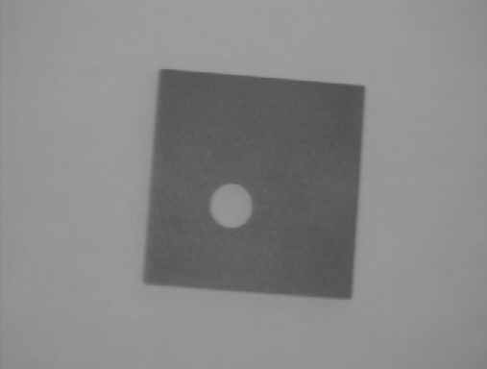

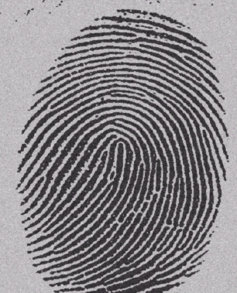
Thresholding
Segmentation into two classes/groups
  Foreground (Objects)
  Background
Image Segmentation

Slide 5
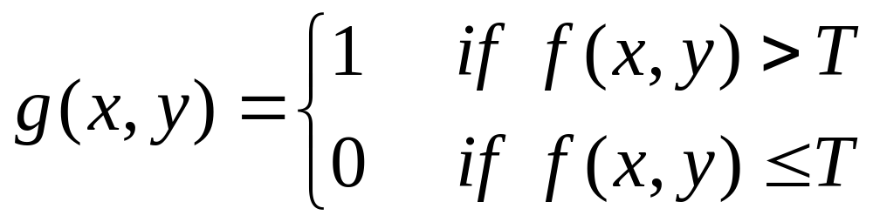
Thresholding
Objects & Background
Image Segmentation

Slide 6
Thresholding
GLOBAL
ADAPTIVE
LOCAL
Image Segmentation

Slide 7
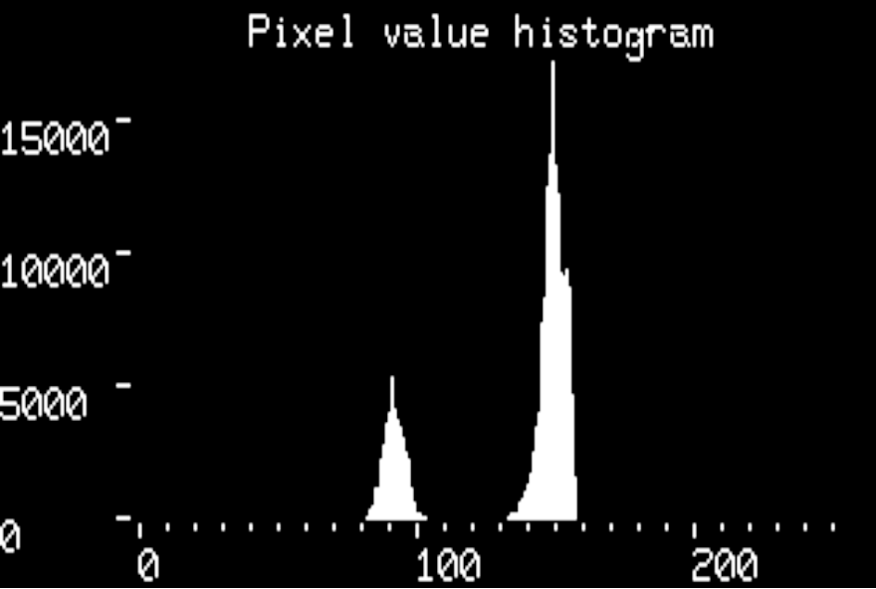
Global Thresholding
Single threshold value for entire image
Fixed ?
Automatic
  Intensity histogram
Image Segmentation

Slide 8

Global Thresholding
Single threshold value for entire image
Fixed ?
Automatic
  Intensity histogram
Image Segmentation

Slide 9
Global Thresholding
Estimate an initial T
Segment Image using T: Two groups of pixels G1 and G2
Compute average gray values m1 and m2 of two groups
Compute new threshold value T=1/2(m1+m2)
Repeat steps 2 to 4 until: abs(T_{i} – T_{i-1})<epsilon
Image Segmentation

Slide 10
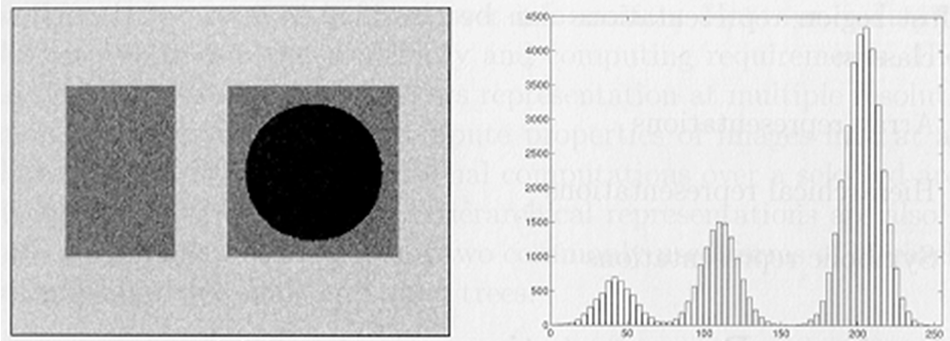
Global Thresholding
Multilevel thresholding
Image Segmentation

Slide 11

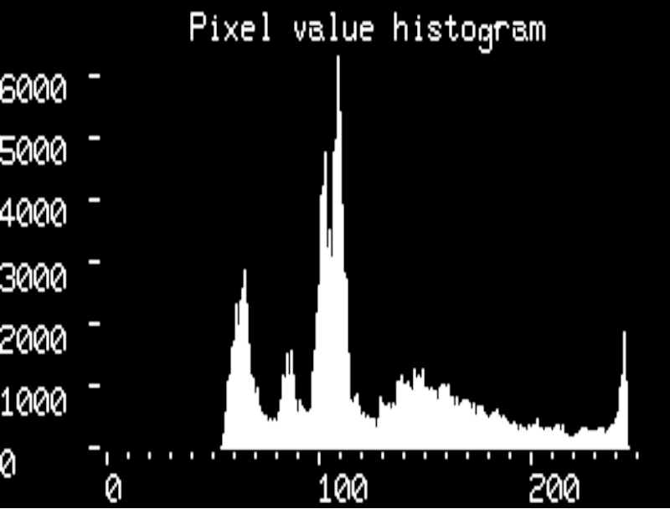
Thresholding
Non-uniform illumination:
Image Segmentation

Slide 12


Global Thresholding
Image Segmentation

Slide 13
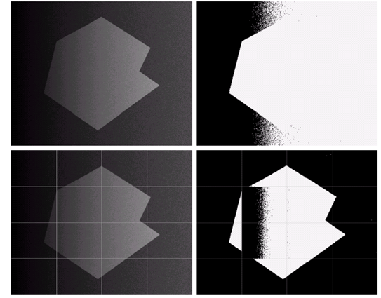
Adaptive Thresholding
Image Segmentation

Slide 14
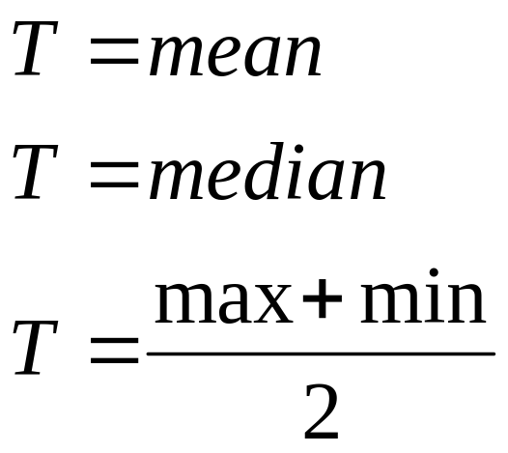
Local Adaptive Thresholding
Threshold: function of neighboring pixels
Image Segmentation

Slide 15
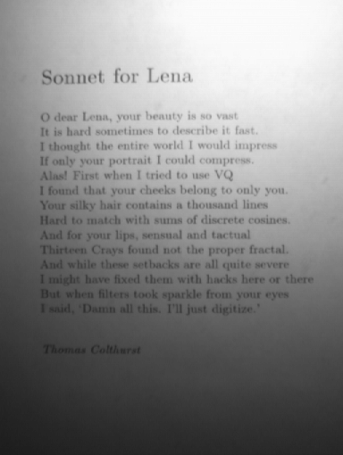
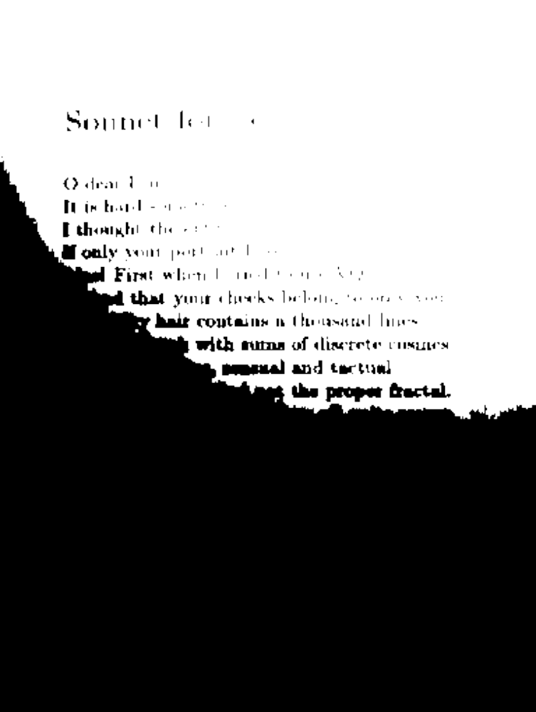
Local Adaptive Thresholding
Original Image
Global Thresholding
Image Segmentation

Slide 16
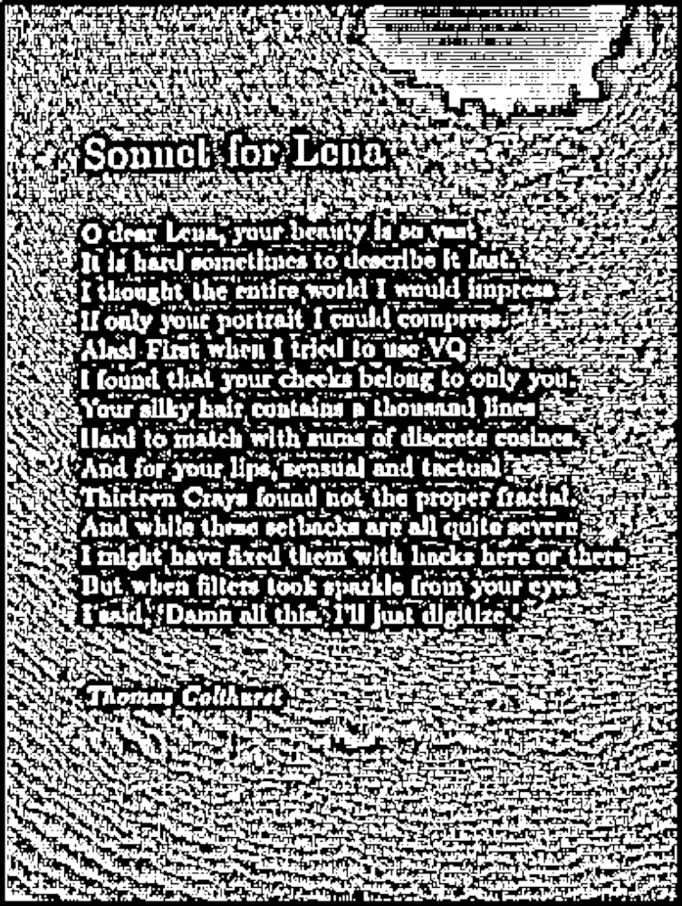
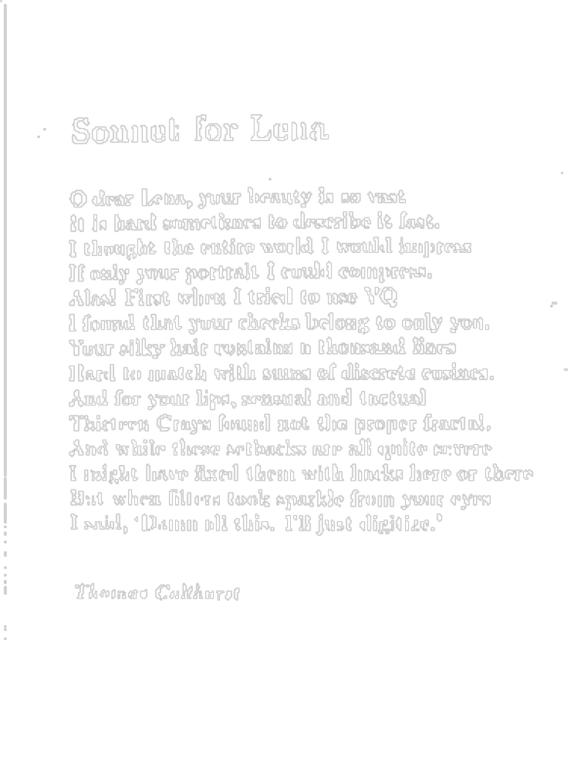
Local Adaptive Thresholding
T=mean, neighborhood=7x7
T=mean-Const., neighborhood=7x7
Image Segmentation

Slide 17
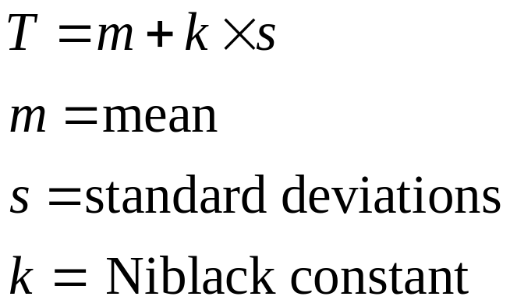
Local Adaptive Thresholding
Niblack Algorithm
Neighborhood size???
Image Segmentation

Slide 18
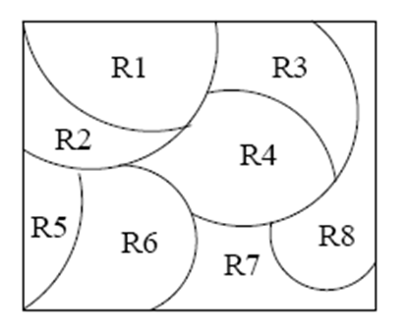
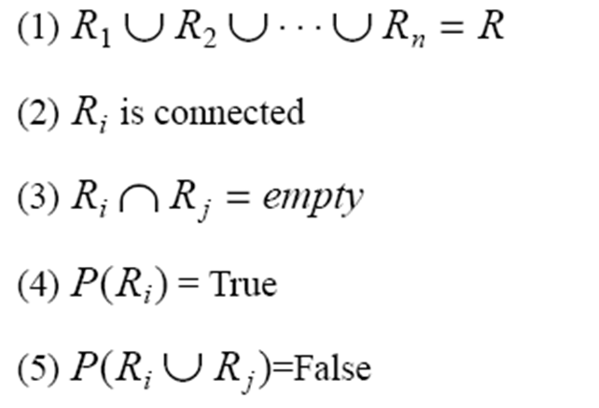
Region-Based Segmentation
Divide the image into regions
  R₁,R₂,…,R_{N}
Following properties must hold:
(For adjacent regions)
Image Segmentation

Slide 19
Region-Based Segmentation
Region Growing
  Region growing: groups pixels or subregions into larger regions.
  Pixel aggregation: starts with a set of “seed” points and from these grows regions by appending to each seed points those neighboring pixels that have similar properties (such as gray level).
Choose the seed pixel.
Check the neighboring pixels and add them to the region if they are similar to the seed
Repeat step 2 for each of the newly added pixels; stop if no more pixels can be added
Predicate: for example abs(z_{j} - seed) < Epsilon
Image Segmentation

Slide 20
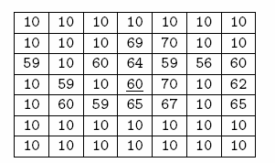
Region-Based Segmentation
Example
Image Segmentation

Slide 21
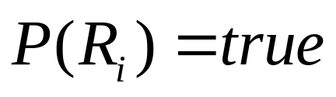
Region-Based Segmentation
Region Splitting
  Region growing: Starts from a set of seed points.
  Region Splitting: Starts with the whole image as a single region and subdivide the regions that do not satisfy a condition.
  Image = One Region R
  Select a predicate P (gray values etc.)
  Successively divide each region into smaller and smaller quadrant regions so that:
Image Segmentation

Slide 22
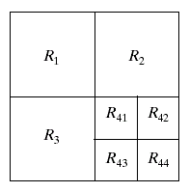
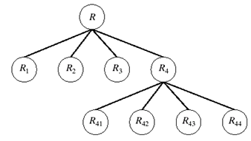
Region-Based Segmentation
Region Splitting
Problem?
Adjacent regions could be same
Solution?
Allow Merge
Image Segmentation

Slide 23
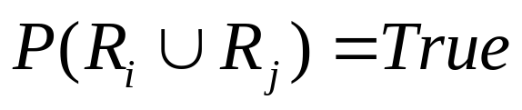
Region-Based Segmentation
Region Merging
  Region merging is the opposite of region splitting.
  Merge adjacent regions R_{i} and R_{j} for which:
Region Splitting/Merging
  Stop when no further split or merge is possible
Image Segmentation

Slide 24
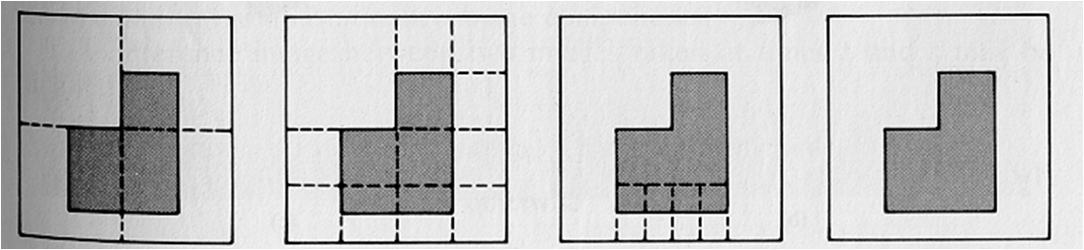
Region-Based Segmentation
Example
Split into four disjointed quadrants any region R_{i} where P(R_{i})=False
Merge any adjacent regions R_{j} and R_{k} for which P(R_{j} U R_{k})=True
Stop when no further merging or splitting is possible
Image Segmentation

Slide 25
K-Means Clustering
Chose the number (K) of clusters and randomly select the centroids of each cluster.
For each data point:
  Calculate the distance from the data point to each cluster.
  Assign the data point to the closest cluster.
Recompute the centroid of each cluster.
Repeat steps 2 and 3 until there is no further change in the assignment of data points (or in the centroids).
Image Segmentation

Slide 26
K-Means Clustering
Image Segmentation

Slide 27
K-Means Clustering
Image Segmentation

Slide 28
K-Means Clustering
Image Segmentation

Slide 29
K-Means Clustering
Image Segmentation

Slide 30
K-Means Clustering
Image Segmentation

Slide 31
K-Means Clustering
Image Segmentation

Slide 32
K-Means Clustering
Image Segmentation

Slide 33
K-Means Clustering
Image Segmentation

Slide 34
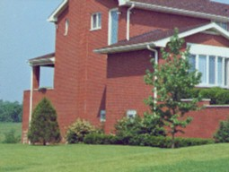
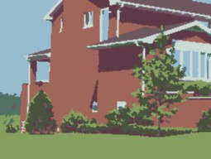
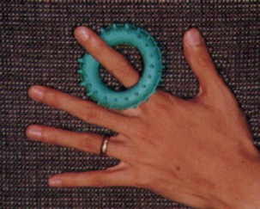

Clustering
Example
D. Comaniciu and P. Meer, Robust Analysis of Feature Spaces:
Color Image Segmentation, 1997.
Image Segmentation

Slide 35
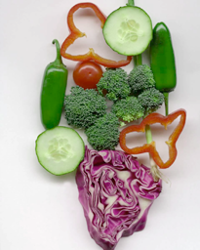
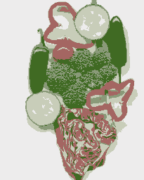
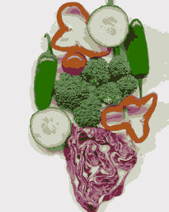
K-Means Clustering
Example
Original
K=5
K=11
Image Segmentation

Slide 36
References
Chapter # 10, DIP by Gonzalez & Woods
Lecture slides by Prof. George Bebis
  University of Nevada
Lecture slides by Prof. Bahadir K. Gunturk
  Louisiana State University
http://homepages.inf.ed.ac.uk/rbf/HIPR2/
Image Segmentation

